Slide 1
MINOR PROJECT- II SECURITY ANALYSIS OF METASPLOITABLE 2 USING NMAP AND NESSUS TEAM:- EUPHORBIA

Slide 2
INTRODUTION
The purpose of this report is to present the activities conducted during Week 02 of the Cybersecurity Internship. The focus of this week's project was to set up and analyze the security of Metasploitable 2, a deliberately vulnerable virtual machine. We were tasked with installing Metasploitable 2, performing a network scan using Nmap, conducting a vulnerability assessment using Nessus, and generating a comprehensive report outlining the identified vulnerabilities and recommended remediation actions.

Slide 3
PROJECT OBJECTIVES
Install and set up Metasploitable 2
Conduct a vulnerability assessment using Nessus
Perform a network scan using Nmap to identify open ports, running services, and vulnerabilities.
Generate a comprehensive report with findings and recommendations

Slide 4
PROJECT METHODOLOGY
METHODOLOGIES
a) Download and install Metasploitable 2 on a virtualization platform.
b) Execute a network scan using Nmap, gathering information about open ports and services.
c) Use Nmap scripts to gather additional information about the identified services.
d) Install and configure Nessus for vulnerability assessment.
e) Conduct a comprehensive vulnerability assessment using Nessus.
f) Analyze Nessus scan results, identify vulnerabilities, and assess their severity.
g) Prepare a comprehensive report documenting findings and recommended remediation actions.

Slide 5


METASPLOITABLE 2 INSTALLATION AND NETWORK CONFIGURATION
The installation process of Metasploitable 2 involves the following steps:
Download the Metasploitable 2 VM from reliable sources.
Choose a virtualization platform like VMware or VirtualBox and install it.
Import the Metasploitable 2 VM image into the virtualization software.
Configure the network settings to establish connectivity.
Start the Metasploitable 2 VM and obtain the login credentials.

Slide 6
NETWORK SCANNING USING NMAP
Nmap, a network scanning tool, was used to perform a scan of Metasploitable 2. The scan helped identify open ports, running services, and potential vulnerabilities. Here are the Nmap scan results: Provide a summary of the open ports discovered during the scan and their associated services. Present the command used to perform the default scan using Nmap. Highlight the important findings, such as open FTP, SSH, Telnet, HTTP, and other services. Discuss the potential risks associated with these open ports and services.

Slide 7
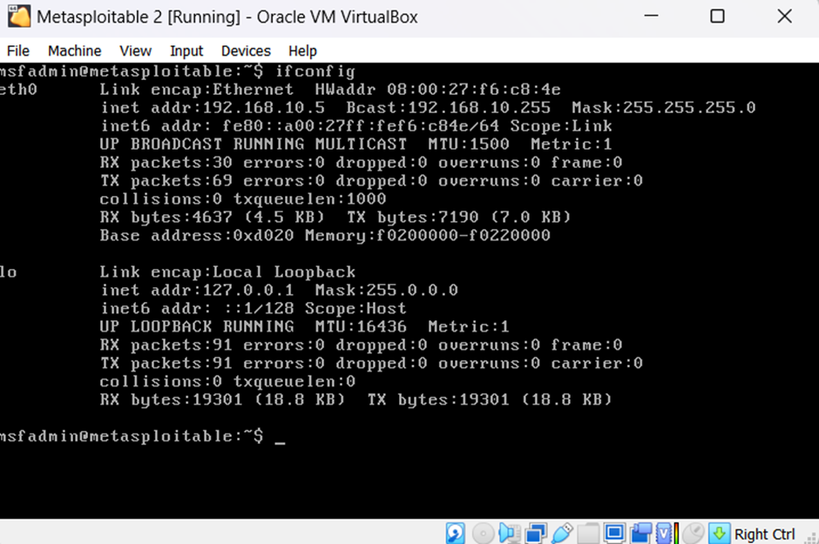
FINDING THE IP ADDRESS OF LINUX MACHINES

Slide 8
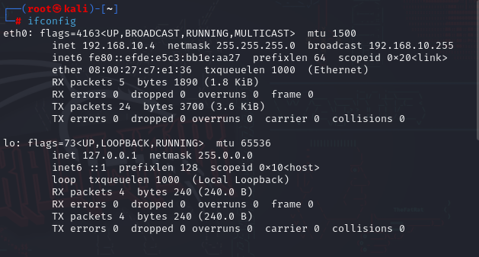

Slide 9
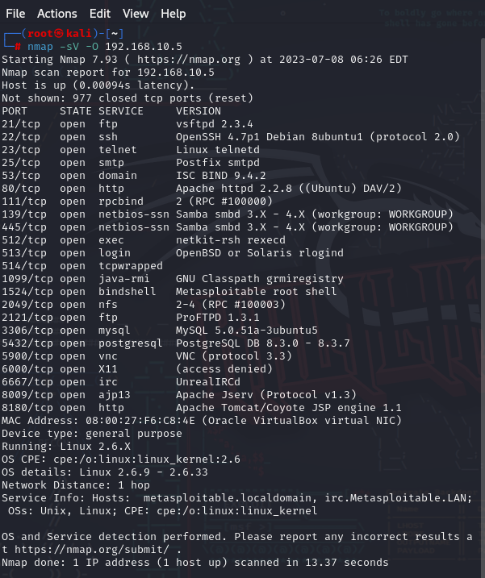
Using Nmap in kali Linux to find the open ports, running services, and potential vulnerabilities

Slide 10
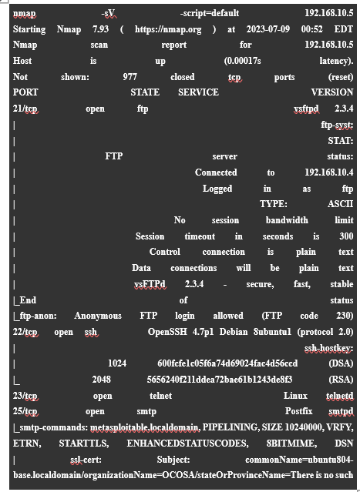
DEFAULT SCAN

Slide 11
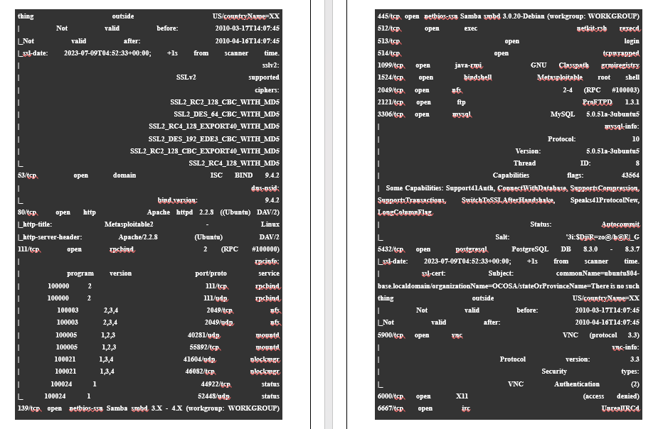
DEFAULT SCAN

Slide 12
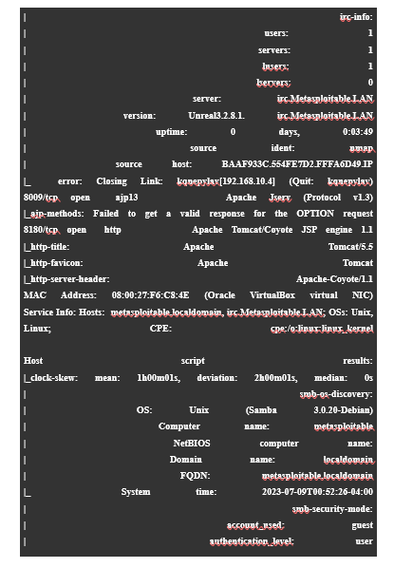
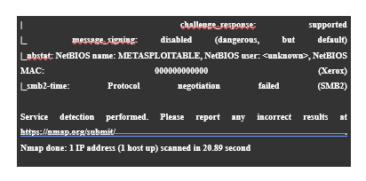
DEFAULT SCAN

Slide 13
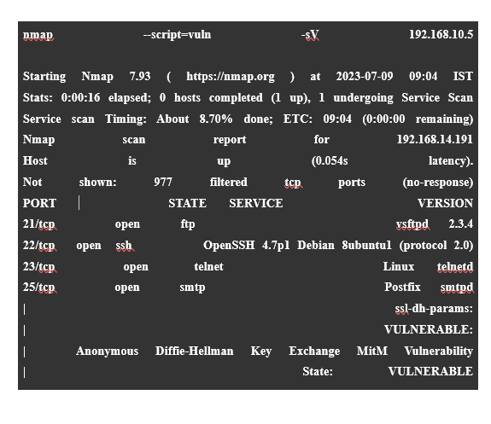
VULNERABILITY SCAN

Slide 14
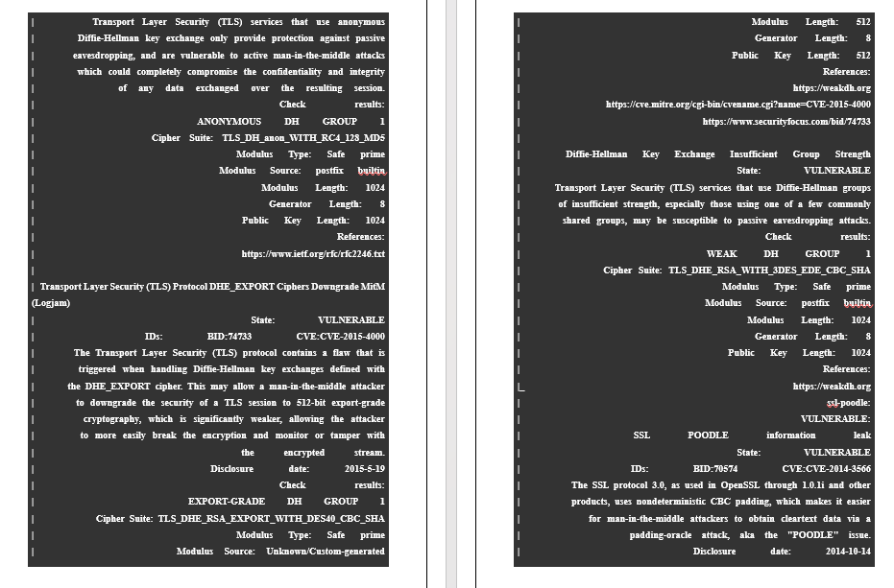
VULNERABILITY SCAN

Slide 15
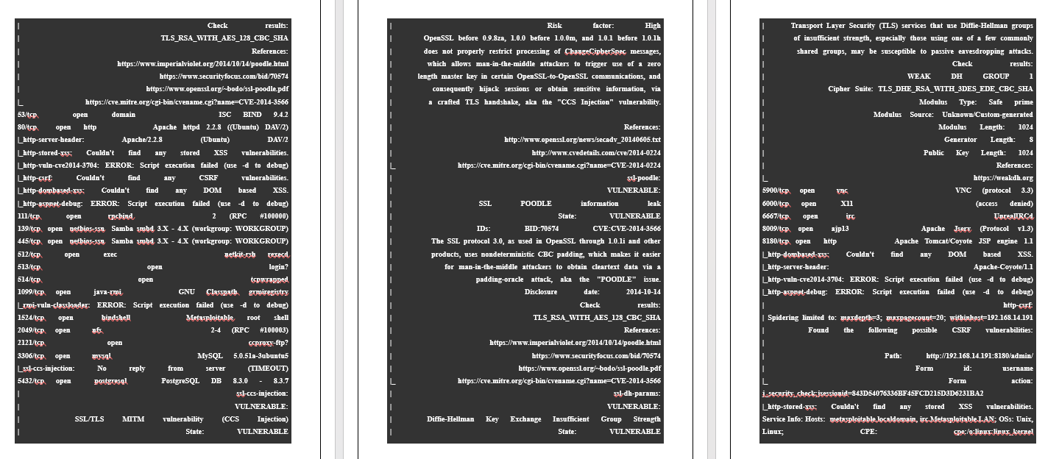
VULNERABILITY SCAN

Slide 16
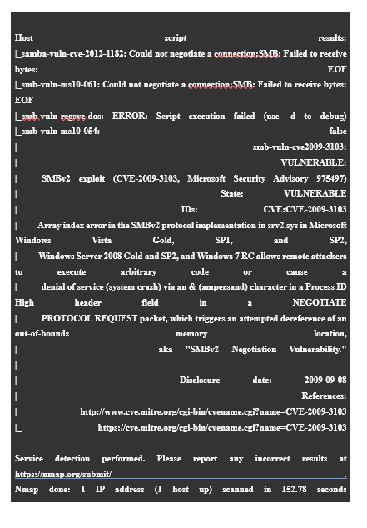
VULNERABILITY SCAN

Slide 17
VULNERABILITY ASSESSMENT USING NESSUS
Nessus, a vulnerability scanner, was used to conduct a comprehensive vulnerability assessment of Metasploitable 2.
Here is an overview of the Nessus scan results:
Discuss the purpose and importance of vulnerability assessments.
Present the command used to perform the vulnerability scan with Nessus.
Share notable vulnerabilities identified during the scan, including their severity levels and potential impacts.
Emphasize critical, high, and medium severity vulnerabilities and their potential risks.

Slide 18
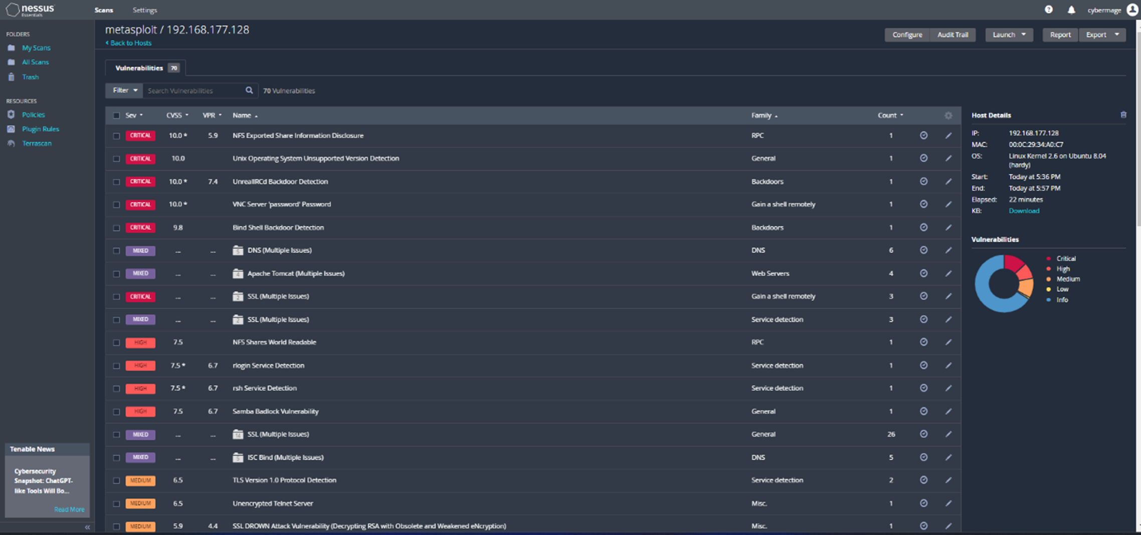
NESSUS SCAN RESULTS
The Nessus scan generated detailed results, including identified vulnerabilities, severity levels, and potential impacts. Notable findings include:

Slide 19
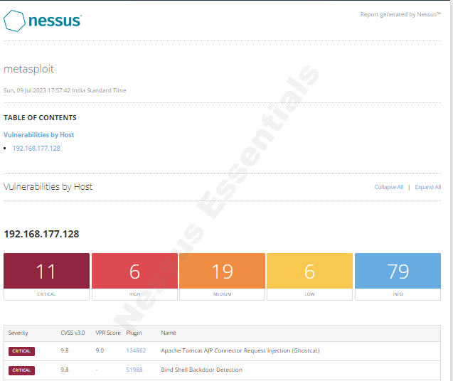
VULNERABILITIES DESCRIPTION
1. Vulnerability : Unix OS Unsupported Version Detection
Description: This vulnerability refers to the detection of an outdated and unsupported version of the Unix operating system on the target system.
Severity Level: CRITICAL
Potential Impact: Lack of security updates
Vulnerability : rlogin Service Detection
Description: The rlogin service is detected on the target system, which poses security risks due to its lack of encryption and weak authentication.
Severity Level: MEDIUM
Potential Impact: Unauthorized access

Slide 20
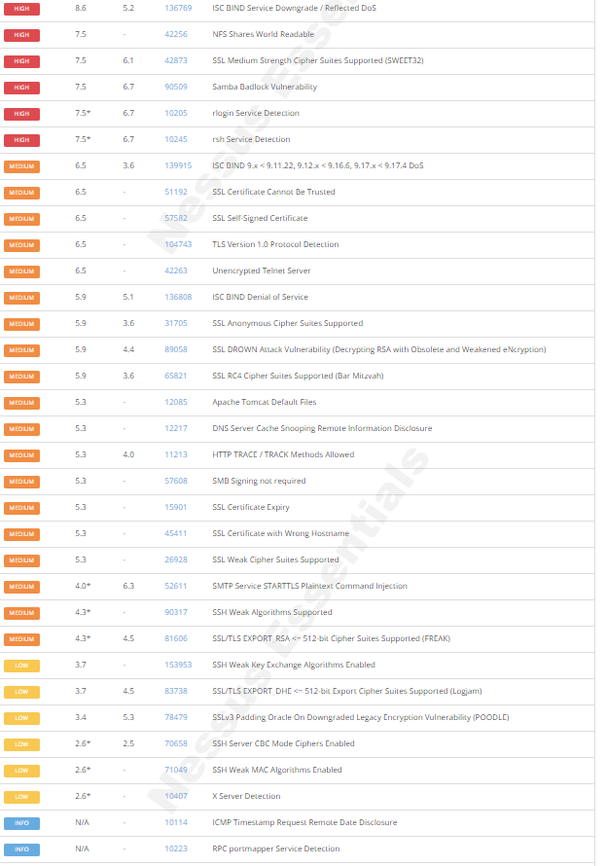
VULNERABILITIES DESCRIPTION
3. Vulnerability : X Server Detection
Description: The presence of Xserver, a component of the X Window System, is detected on the target system.
Severity Level: LOW
Potential Impact: Unauthorized access

Slide 21


RECOMMENDED REMEDIATION ACTIONS
Based on the identified vulnerabilities, provide recommended remediation actions to improve the security of Metasploitable 2. Here are some examples:
Upgrade the unsupported Unix OS version to a supported and patched version.
Disable the rlogin service and switch to SSH for secure remote access.
Secure Xserver with proper configurations and access controls.
Regularly update software and services to address known vulnerabilities.
Implement network segmentation and access controls to limit unauthorized access.
Conduct regular security assessments and vulnerability scans.
Provide training on secure practices for users and administrators.

Slide 22


CONCLUSION AND RECOMMENDATIONS
In conclusion, the security analysis of Metasploitable 2 using Nmap and Nessus helped identify several vulnerabilities. By implementing the recommended remediation actions, the overall security posture of Metasploitable 2 can be significantly improved.
RECOMENDATIONS
Address the identified vulnerabilities promptly to mitigate potential risks.
Regularly update and patch software to ensure the latest security fixes.
Conduct periodic vulnerability assessments and network scans.
Provide ongoing training and awareness programs on cybersecurity best practices.
By following these recommendations, the security of Metasploitable 2 can be enhanced, reducing the risk of unauthorized access, data breaches, and exploitation.

Slide 23

TEAM MEMBERS
Jay Sakshee
Niyati Shubham
Pawan Ahmed
Aditya Ayaan
Jiyanshu Prince
Aasif Kirti
Mrunal Omkar
Piyush Sampada
Prathmesh Anubhav
Harsh

Slide 24


THANK YOU!

